Slide 1
C++

Slide 2
Introduction:
C++ is a middle-level programming language
C++ developed in 1980 by Bjarne Stroustrup at bell laboratories of AT&T (American Telephone & Telegraph), located in U.S.A.
C++ runs on a variety of platforms, such as Windows, Mac OS, and the various versions of UNIX.
It was develop for adding a feature of OOP (Object Oriented Programming) in C without significantly changing the C component.

Slide 3
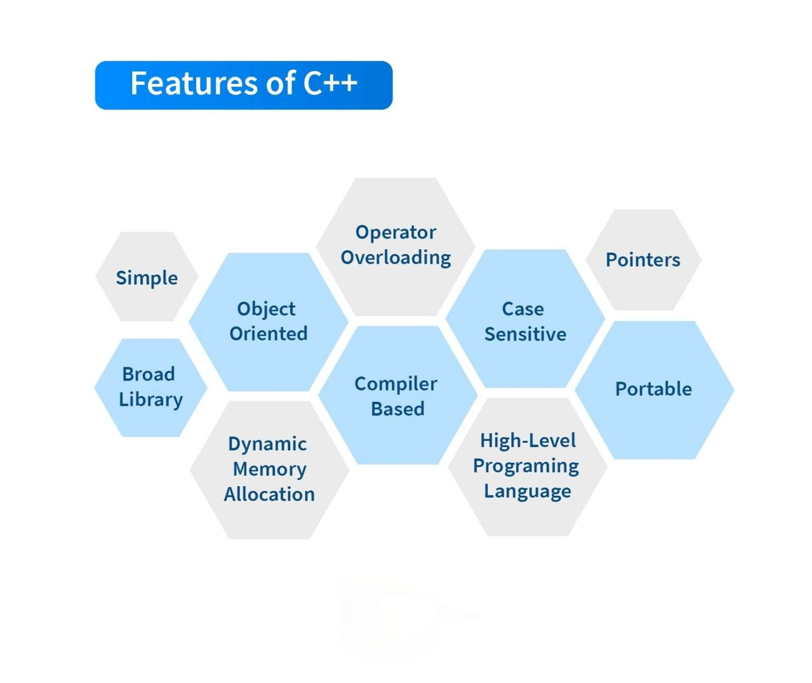

Slide 4
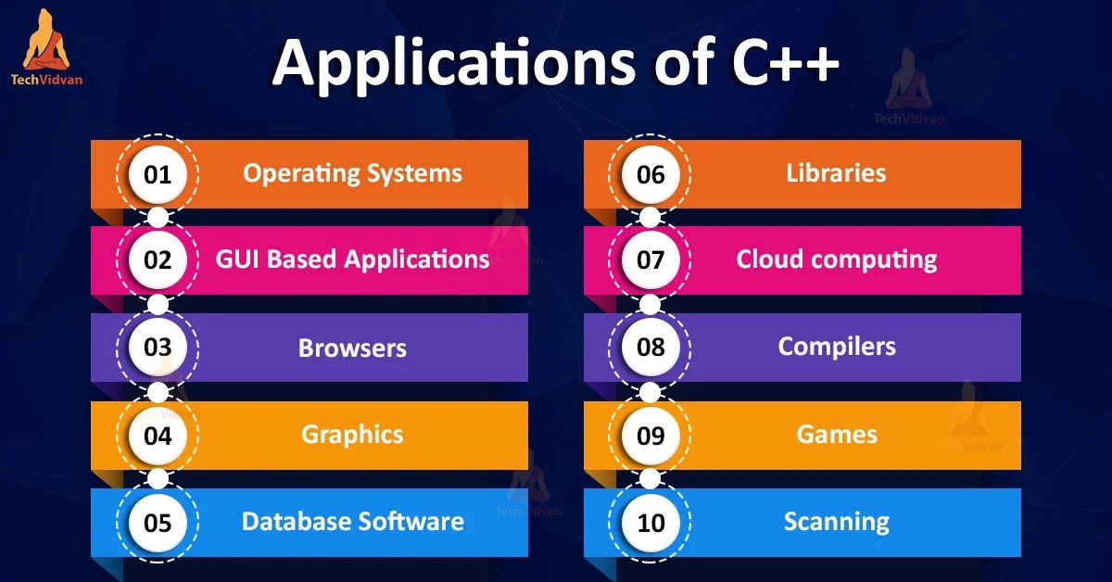

Slide 5
Basic I/O:
Output function is used to print the output and input is used to get user input.
Cout<< is used to print the Output
Cin>> is used to get input (<< , >>- insertion operator)
Cout stans for character output device
Cin stands for Character input.
inserting the endl manipulator ends the line

Slide 6
Basic Program:
#include <iostream>
using namespace std;
int main( ) {
int age;
cout << "Enter your age: ";
cin >> age;
cout << "Your age is: " << age << endl;
}

Slide 7
Variables:
A variable is an identifier which is used to store some value.
A variable name should consist of only characters, digits and an underscore.
A variable name should not begin with a number, not consist of whitespace and keyword.
You will use extern keyword to declare a variable at any place.
Variable Declaration:
Syntax: datatype var_name = value;
Example: int a=5;
int b(3);
int c{2};

Slide 8
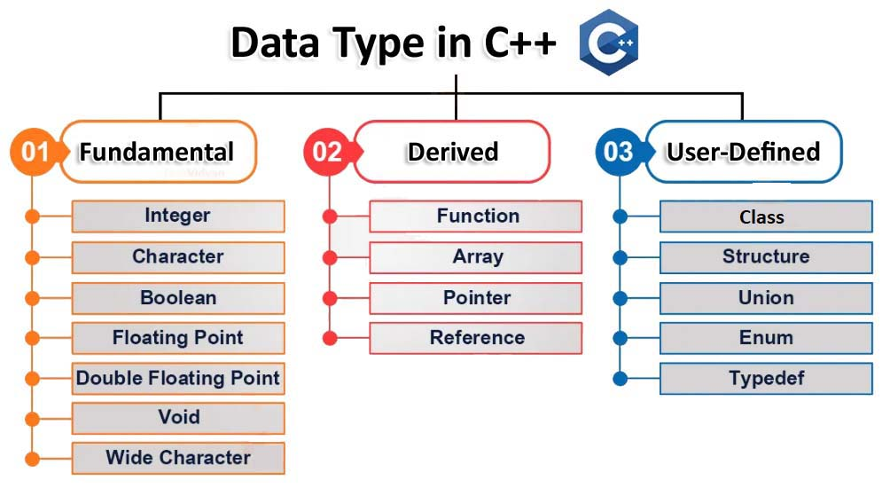
Datatypes:
Type of data with storage capacity is called Data Type.

Slide 9
Constant:
Constants are the fixed values that never change during the execution of a program.
There are two simple ways in C++ to define constants
Using #define preprocessor.
Using const keyword.

Slide 10
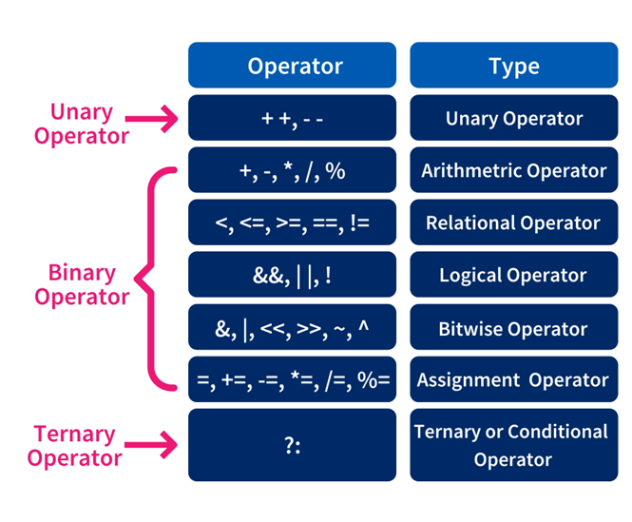
Operators:

Slide 11
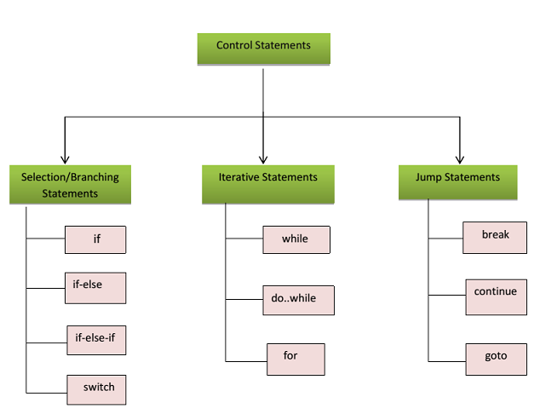
Control Statements:

Slide 12
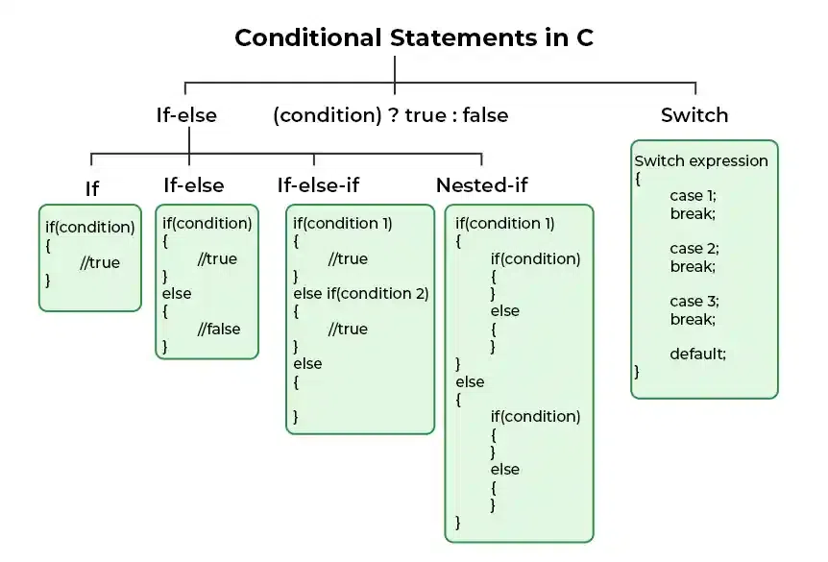

Slide 13
Looping:
1. for(initializer; condition; increment/decrement) {
//statement;
}
2. while(condition) {
//statement;
increment;
}
3. Do {
//statement;
increment;
}while(condition);

Slide 14
Jumping Statement:
Break:
To stop the flow the program.
Continue:
To skip the particular value in the flow of program.
Goto:
To jump in any statement which is refered.
Return:
To return a data in function to function call.

Slide 15
Functions:
A Function can be defined as a subdivided program of the main program enclosed within flower brackets.
Advantages of Functions:
Writing the same code repeatedly in a program will be avoided.
Functions can be called any number of times in a program.
Tracking a C program easily when it is divided into multiple functions.
Reusability is the main achievement of C functions.

Slide 16
Types:
Function without arguments and without return value
Function without arguments and with the return value
Function with arguments and without return value
Function with arguments and with the return value
Syntax:
returntype functionName(arguments)
{
//Statements;
}

Slide 17
Namespace:
A Namespace is used as additional information to differentiate similar functions, classes, variables etc. with the same name available in different libraries.
Using namespace, you can define the context in which names are defined. In essence, a namespace defines a scope.
Daclaration:
namespace namespace_name {
// code declarations
}
name::code;

Slide 18
Array:
An array is defined as the collection of similar type of data items stored at contiguous memory locations.
The array is the simplest data structure where each data element can be randomly accessed by using its index number.
Syntax:
datatype arrayName[array size];
Example:
int a[5]={1,2,3,4,5};

Slide 19
Types of Arrays:
One-Dimensional Array→ an array with a single row and multiple columns
int arrayone[3]={1,2,3};
Two-Dimensional Array→ 2D the collection of rows and columns
int arraytwo[2][2 ]={{1,2},{3,4}};
Three-Dimensional Array→3D as the collection of multiple rows and columns
int arraythree[10][10][10];

Slide 20
String:
In C++, string is an object of std::string class that represents sequence of characters.
We can perform many operations on strings such as concatenation, comparison, conversion etc.
Example:
string s1 = "Hello";
char ch[] = { 'C', '+', '+'};
string s2 = string(ch);
cout<<s1<<endl;
cout<<s2<<endl;

Slide 21
String Operations:
str.length() or str_obj.size() → returns the length of string name.
str.at(index); → returns a character present in index position.
str.append(string2) →Add a string in another string.
Str.find(var); →find a particular word in string.
str1.erase(start, end); → Deleting a word in string.
str1.replace(index, size, str2);→ replacing a particular word in string.
str1.substr(start, size); → returns a particular word from string.
str1.insert(index, str2); → Inserting a word into string using index.
str1.compare(str2); → compares the first string with second string. If both strings are same, it returns 0.

Slide 22
Pointers:
The pointer is a variable which stores the address of another variable.
This variable can be of type int, char, array, function, or any other pointer.
The size of the pointer depends on the architecture.
However, in 32-bit architecture the size of a pointer is 2 byte.
Example:
int n = 10;
int* p = &n;

Slide 23
Dynamic Memory:
Memory in your C++ program is divided into two parts:
The stack − All variables declared inside the function will take up memory from the stack.
The heap − This is unused memory of the program and can be used to allocate the memory dynamically when program runs.
You can allocate memory at run time within the heap for the variable of a given type using a special operator in C++ which returns the address of the space allocated. This operator is called new operator.
If you are not in need of dynamically allocated memory anymore, you can use delete operator, which de-allocates memory that was previously allocated by new operator.

Slide 24
new
object
object2
object1
Main()
Stack
Heap

Slide 25
Example:
#include <iostream>
using namespace std;
int main () {
double* pvalue = NULL;
pvalue = new double
*pvalue = 29494.99
cout << "Value of pvalue : " << *pvalue << endl;
delete pvalue;
return 0;
}

Slide 26
Structure:
structure is another user defined data type which allows you to combine data items of different kinds.
Example:
struct Books {
char title[50];
char author[50];
char subject[100];
int book_id;
} book;
Memory Unit
Title
author
subject
Book_id

Slide 27
Union:
Union can be defined as a user-defined data type which is a collection of different variables of different data types in the same memory location.
The union can also be defined as many members, but only one member can contain a value at a particular point in time.
Union is a user-defined data type, but unlike structures, they share the same memory location.
Example:
union numbers {
int a;
char b;
}var;
Memory Unit
a / b

Slide 28
Enum:
The C++ enum constants are static and final implicitly.
C++ Enums can be thought of as classes that have fixed set of constants.
Example:
#include <iostream>
using namespace std;
enum week { Monday, Tuesday, Wednesday, Thursday, Friday, Saturday, Sunday };
int main() {
week day;
day = Friday;
cout << "Day: " << day+1<<endl;
return 0;
}

Slide 29
Typedef:
The typedef is a keyword used to provide some meaningful names to the already existing variable.
we can say that this keyword is used to redefine the name of an already existing variable.
Example:
typedef int student;
student id = 101;
student fees = 1000;
cout<<“ID = “<<id<<“\nFees = “<<fees<<endl;

Slide 30
Oops:

Slide 31
Introduction:
Object Oriented Programming is a paradigm that provides many concepts such as inheritance, data binding, polymorphism etc.
The programming paradigm where everything is represented as an object is known as truly object-oriented programming language.
Object-Oriented Programming is a methodology or paradigm to design a program using classes and objects.
It simplifies the software development and maintenance by providing some concepts.

Slide 32
Concepts:
Access Modifier:
Class ana Objects
Inheritance
Polymorphism
Encapsulation
Abstraction
Public
Private
Protected
default

Slide 33
Class :
When you define a class, you define a blueprint for a data type.
A class definition starts with the keyword class followed by the class name; and the class body, enclosed by a pair of curly braces.
A class definition must be followed either by a semicolon or a list of declarations.
Example:
class class_name {
access_specifier_1:
member1;
access_specifier_2:
member2;
} object_names;

Slide 34
Encapsulation:
Encapsulation is an Object Oriented Programming concept that binds together the data and functions that manipulate the data, and that keeps both safe from outside interference and misuse.
Data encapsulation led to the important OOP concept of data hiding.
Abstraction:
Data abstraction refers to providing only essential information to the outside world and hiding their background details.
Data abstraction is a programming (and design) technique that relies on the separation of interface and implementation.

Slide 35
Inheritance
One of the most important concepts in object-oriented programming is that of inheritance.
Inheritance allows us to define a class in terms of another class, which makes it easier to create and maintain an application.
This also provides an opportunity to reuse the code functionality and fast implementation time.
This existing class is called the base class, and the new class is referred to as the derived class.

Slide 36
Types:
Single Inheritance
Multi-level Inheritance
Multiple Inheritance
Hierarchical Inheritance
Hybrid Inheritance
Syntax:
class <DerivedClassName>: public <BaseClassName>

Slide 37
Polymorphism
The word polymorphism means having many forms.
Same person plays a different role is called polymorphism.
Typically, polymorphism occurs when there is a hierarchy of classes and they are related by inheritance.
C++ polymorphism means that a call to a member function will cause a different function to be executed depending on the type of object that invokes the function.

Slide 38
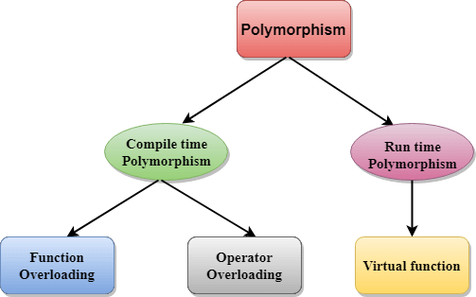
Types:

Slide 39
OverLoading:
C++ allows you to specify more than one definition for a function name or an operator in the same scope, which is called function overloading and operator overloading respectively.
The process of selecting the most appropriate overloaded function or operator is called overload resolution.
Operator Overloading:
It has same operator performing more than one time.
We can Achieve Operator overloading by operator() function.
We cannot overload these operators ( . , :: , ?: ) .
Function Overloading:
It has multiple functions in same name and differentciated with arguments.

Slide 40
Virtual Function:
A virtual function is a function in a base class that is declared using the keyword virtual.
Defining in a base class a virtual function, with another version in a derived class, signals to the compiler that we don't want static linkage for this function.
Friend Function:
In principle, private and protected members of a class cannot be accessed from outside the same class in which they are declared.
Friends are functions or classes declared with the friend keyword.
A non-member function can access the private and protected members of a class if it is declared a friend of that class

Slide 41
Exception Handling:
Exception is a problem that arise during the execution time
An abnormal event which stops the program abruptly is called Error.
Exception handling is a mechanism to handle errors in the runtime.
So that the normal flow of the application is maintained.
Keywords:
1. Try
2. Catch
3. Throw

Slide 42
File I/O
To perform file processing in C++, header files <iostream> and <fstream> must be included in your C++ source file.
A file must be opened before you can read from it or write to it.
Either ofstream or fstream object may be used to open a file for writing.
And ifstream object is used to open a file for reading purpose only.

